Slide 1
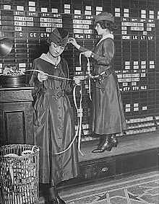
Memory

Slide 2
Two types of memory
Volatile (needs a constant power source to refresh it)
Non-volatile (permanent - doesn't need power)

Slide 3
RAM
One of the most common and well-known types of memory.
RAM speed slower than CPU speed...
...this is why we need cache.
But RAM is volatile...
...so, we need non-volatile memory to store things long term.

Slide 4
Volatile memory
RAM (Random Access Memory)
CMOS (stores BIOS settings)
Video RAM (VRAM)
Cache RAM

Slide 5
Non-volatile memory
Punched cards
Punched tape
Optical storage
Hard drives
Flash memory
Magnetic tape
Floppy disc

Slide 6
Cache
Stores frequently used data
Predicts next data needed
Fast

Slide 7
Where is cache found?
On a CPU (L1 & L2)
On a motherboard (L3)
Hard disc storage for specific applications (eg, web browser)

Slide 8
Cache hits and misses
A successful recall from cache is called a hit
Unsuccessful is a miss

Slide 9
Key terms
RAM - Random Access Memory (eg, DRAM & VRAM)
ROM - Read Only Memory (eg, BIOS)
WORM - Write Once Read Many (eg, CD)
Cache - fast memory holding frequently used data
CMOS - Complimentary Metal Oxide Semiconductor
Cache hit - successful read from cache memory
Cache miss - requested data not cached

